Slide 1
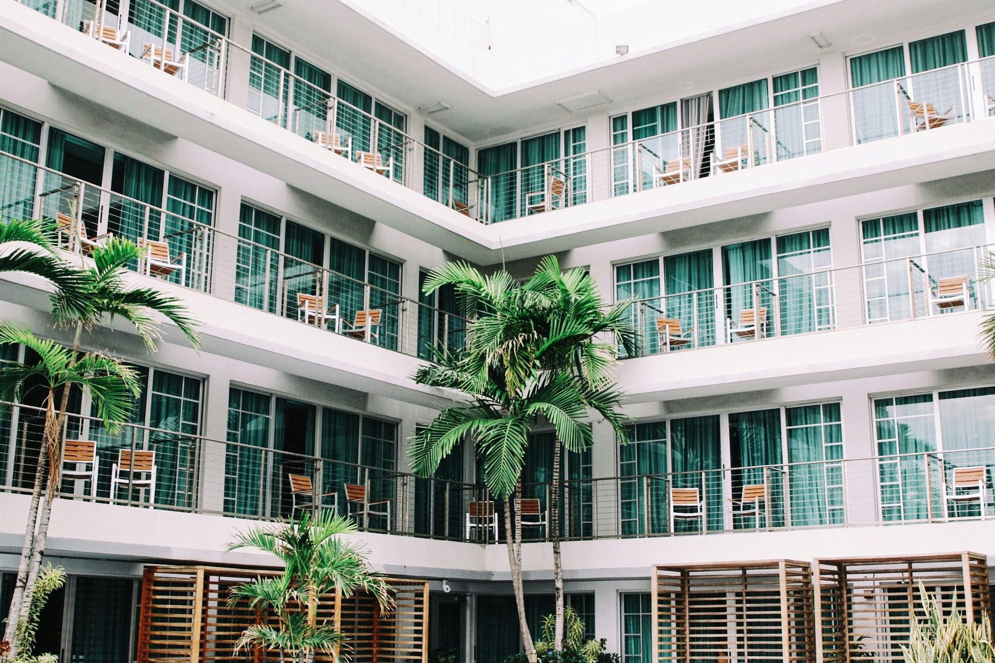
Hotel Reservation Analysis
Title: Hotel Reservation Analysis
Subtitle: Insights and Key Findings
Date: 26th June 2024
Presenter: Ayokunle Ajisafe

Slide 2
Introduction
Objectives:
Understand reservation patterns
Identify key factors influencing bookings
Key Tools: MySQL, PPT
Purpose: To analyze hotel reservation data and derive actionable insights.
Overview of the hotel reservation dataset including key metrics such as total bookings, hotel types, and booking patterns.

Slide 3
Data Collection
Time Period: Duration of data collected is from July 2017 - December 2018)
Data Points: Key variables analyzed;
Booking_ID: A unique identifier for each hotel reservation.
no_of_adults: The number of adults in the reservation.
no_of_children: The number of children in the reservation.
no_of_weekend_nights: The number of nights in the reservation that fall on weekends.
no_of_week_nights: The number of nights in the reservation that fall on weekdays.
type_of_meal_plan: The meal plan chosen by the guests.
room_type_reserved: The type of room reserved by the guests.
lead_time: The number of days between booking and arrival.
arrival_date: The date of arrival.
market_segment_type: The market segment to which the reservation belongs.
avg_price_per_room: The average price per room in the reservation.
booking_status: The status of the booking.

Slide 4
TOTAL BOOKINGS / RESERVATIONS
There was a total number of reservation of about 700 with all having an identical Booking_ID
All of this reservations were made between the period of 2017 to 2018 from the dataset given
From the total reservation, in 2018 the number of reservation made were 577 and while that of 2017 was 123.

Slide 5
TOTAL BOOKINGS / RESERVATIONS
The booking status for each booking_ID that were not cancelled was precisely 493.
There are six type of room reservation:
Room_Type 1
Room_Type 2
Room_Type 4
Room_Type 5
Room_Type 6
Room_Type 7

Slide 6
TOTAL BOOKINGS / RESERVATIONS
The room type with the highest reservation was Room_Type 1 with 534 reservation,
Reservation's made for the Room_Type 1 has an average price of 123.12.
For reservation that involved children the most common room type picked Is also Room_Type 1 and the Average price for any type of room involving children is calculated to be 144.57.

Slide 7
Cancellation of Reservations
We have our total reservation to be 700, and the number of confirmed reservations is 493 then our number of non-confirmed reservation will be 700 - 493 = 20
The percentage of our confirmed reservation is 70.43%
The percentage of non-confirmed reservation is 29.57%

Slide 8
Key Findings
The most commonly booked room type is the Room_Type 1 and the least popular room type is Room_type 5
In the months of September and October for 2017 and 2018 respectively there were a reservations during that period of the year but June of 2018 recorded the highest number of reservations

Slide 9
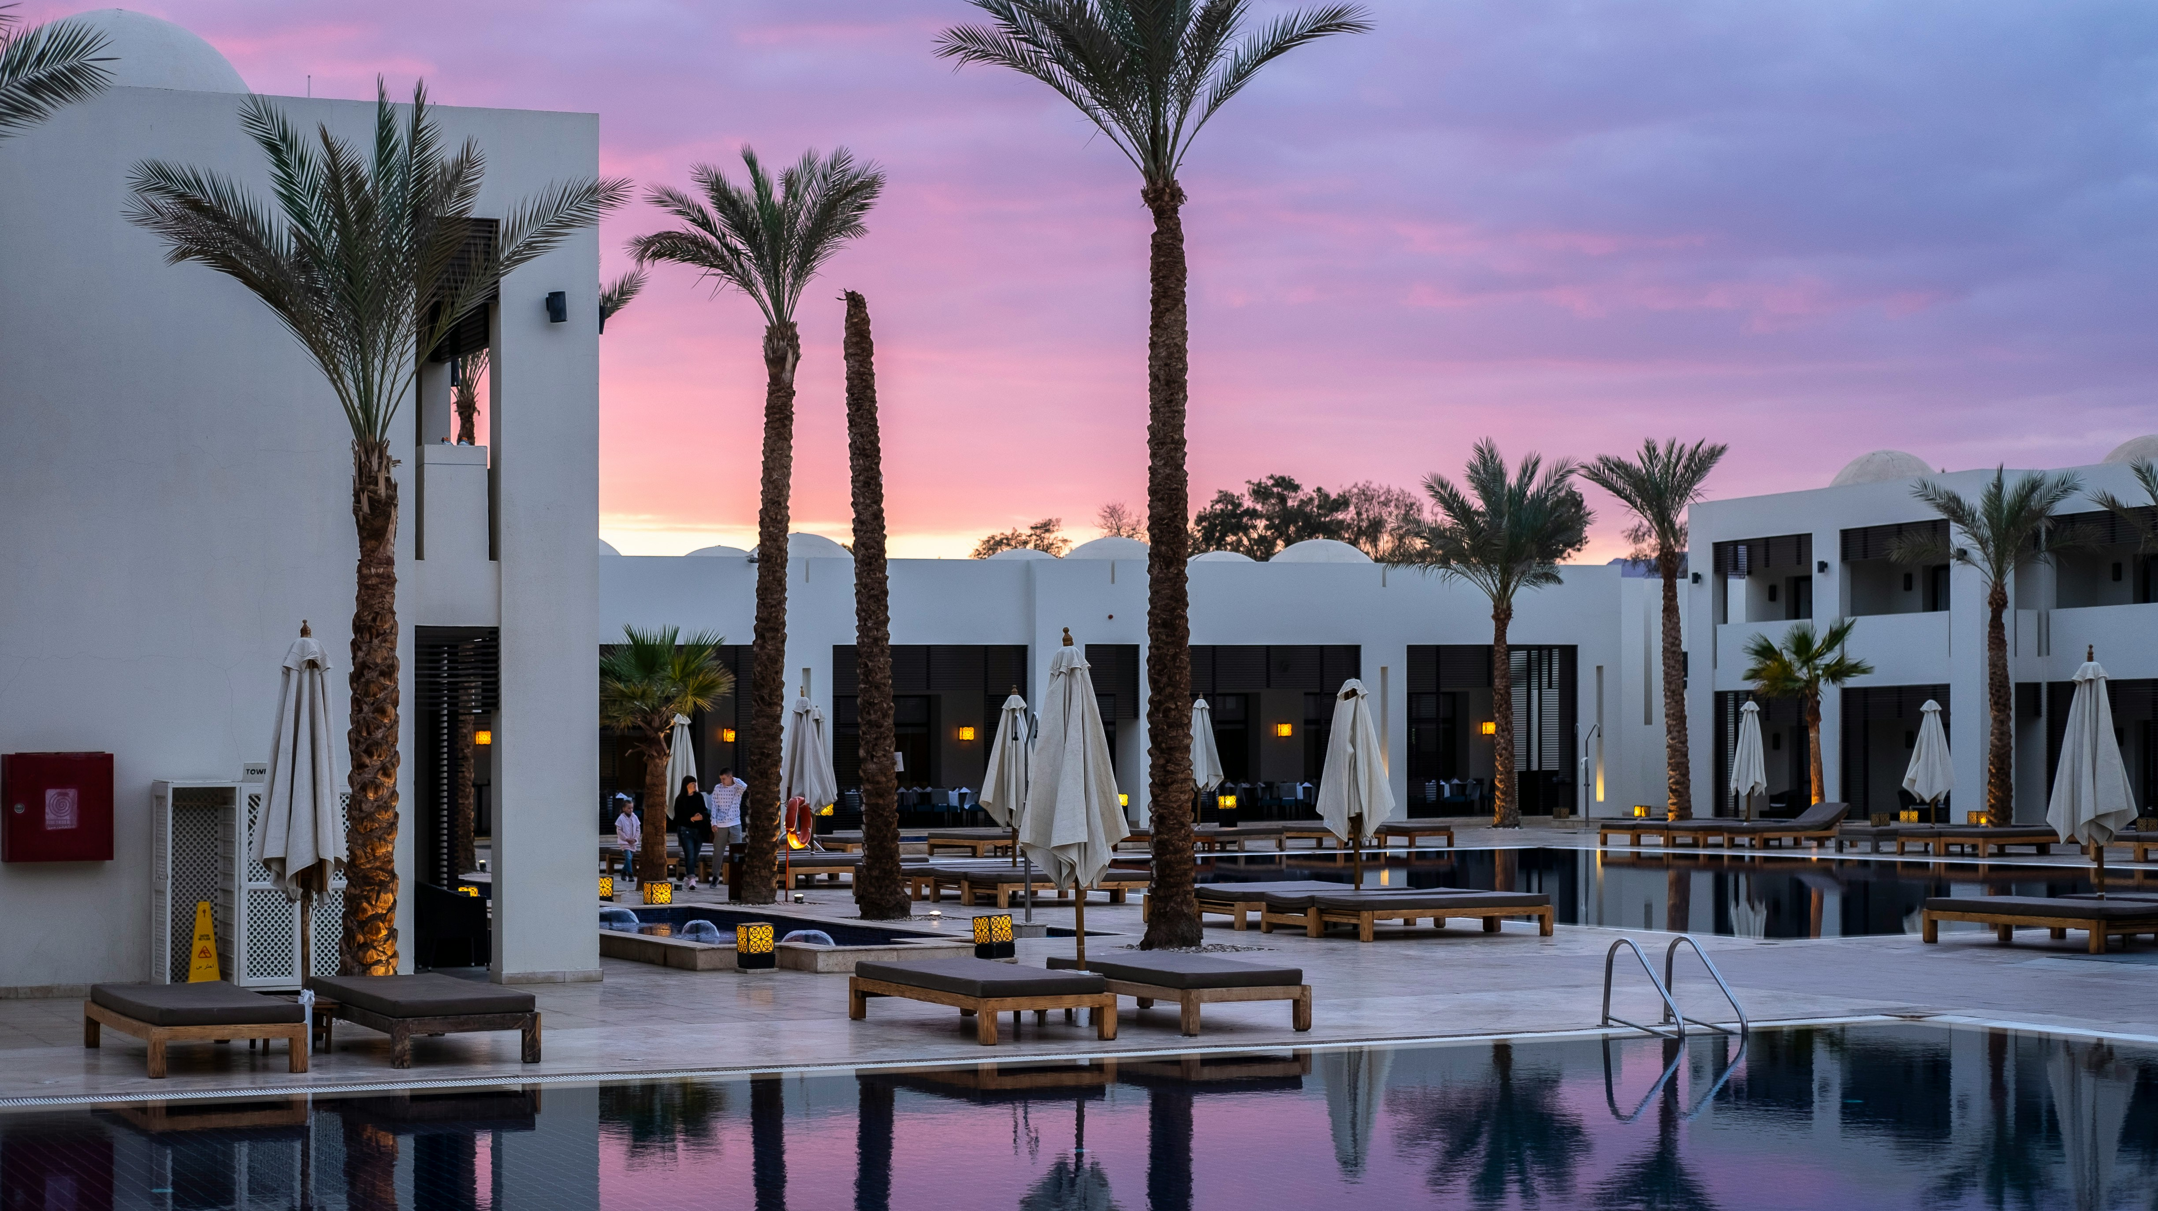
Conclusion
For most reservation made online they were cancelled but all offline reservation were confirmed .

